Slide 1
Chapter 5-Network Performance

Slide 2
Performance
One important issue in networking is the performance of the network—how good is it? The performance is measured by
Bandwidth
Throughput
Latency (Delay)
Bandwidth-Delay Product

Slide 3
Bandwidth
In networking, we use the term bandwidth in two contexts
The first, bandwidth in hertz, refers to the range of frequencies in a composite signal or the range of frequencies that a channel can pass.
The second, bandwidth in bits per second, refers to the speed of bit transmission in a channel or link.
An increase in bandwidth in hertz means an increase in bandwidth in bits per second

Slide 4
Throughput
The throughput is a measure of how fast we can actually send data through a network.
It is the amount of data moved successfully from one place to another in a given time period.
Bandwidth and throughput is not same. For example a link with bandwidth 1 Mbps but can handle only 200 kbps so throughput will be 200 kbps.

Slide 5

Example
A network with bandwidth of 10 Mbps can pass only an average of 12,000 frames per minute with each frame carrying an average of 10,000 bits. What is the throughput of this network?
Solution
We can calculate the throughput as
The throughput is almost one-fifth of the bandwidth in this case.

Slide 6
Propagation Speed
Propagation speed measures the distance a signal or a bit can travel through a medium in one second. The propagation speed of electromagnetic signals depends on the medium and on the frequency of the signal. For example, in a vacuum, light is propagated with a speed of 3×10⁸ m/s. It is lower in air. It is much lower in a cable.
Transmission Speed
Transmission speed is the speed at which all the bits in a message arrive at the destination. (difference in arrival time of first and last bit)

Slide 7
Propagation Time(Delay)
Propagation time measures the time required for a signal (or a bit) to travel from one point of the transmission medium to another. The propagation time is calculated by dividing the distance by the propagation speed.
Propagation time (Propagation Delay) =Distance/Propagation speed

Slide 8
Transmission Time (Delay))
And transmission delay is the time to transmit a whole packet over a link.
the transmission time, is the amount of time from the beginning until the end of a message transmission. In the case of a digital message, it is the time from the first bit until the last bit of a message has left the transmitting node.
Transmission delay is a function of the packet's length and has nothing to do with the distance between the two nodes. This delay is proportional to the packet's length in bits.
This is the delay caused by the data-rate of the link. Transmission time
(Transmission Delay) = Message size/bandwidth bps
http://www.ccs-labs.org/teaching/rn/animations/propagation/

Slide 9
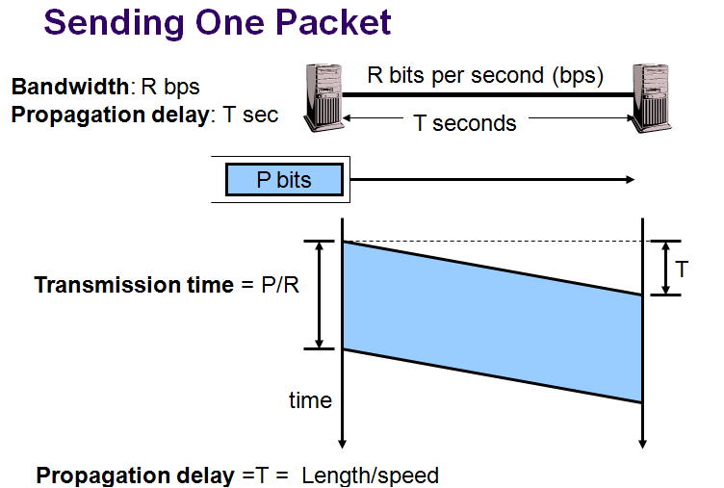
Transmission Time (Delay))

Slide 10
Queuing time
Queuing time is the required time for each intermediate or end device to hold the message before it can be processed.
Latency = Propagation delay + Transmission delay + Queuing time + Processing time

Slide 11

Problem
What is the propagation time if the distance between the two points is 12,000 km? Assume the propagation speed to be 2.4 × 10⁸ m/s in cable.
Solution
We can calculate the propagation time as

Slide 12

Problem
What are the propagation time and the transmission time for a 2.5-kbyte message (an e-mail) if the bandwidth of the network is 1 Gbps? Assume that the distance between the sender and the receiver is 12,000 km and that light travels at 2.4 × 10⁸ m/s.
Solution
Note that in this case, because the message is short and the bandwidth is high, the dominant factor is the propagation time, not the transmission time. The transmission time can be ignored.

Slide 13

Problem
What are the propagation time and the transmission time for a 5-Mbyte message (an image) if the bandwidth of the network is 1 Mbps? Assume that the distance between the sender and the receiver is 12,000 km and that light travels at 2.4 × 10⁸ m/s.
Solution
Note that in this case, because the message is very long and the bandwidth is not very high, the dominant factor is the transmission time, not the propagation time. The propagation time can be ignored.

Slide 14

Wavelength and period
Wavelength binds the period or the frequency of a simple sine wave to the propagation speed of the medium.
While the frequency of a signal is independent of the medium, the wavelength depends on both the frequency and the medium
The wavelength is the distance a simple signal can travel in one period

Slide 15
Wavelength and period
Wavelength can be calculated if one is given the propagation speed (the speed of light) and the period of the signal.
Wavelength = Propagation speed x Period
However, since period and frequency are related to each other, if can say
Wavelength = Propagation speed / Frequency
The propagation speed of electromagnetic signals depends on the medium and on the frequency of the signal. For example, in a vacuum, light is propagated with a speed of 3 x 10⁸ m/s. That speed is lower in air and even lower in cable.

Slide 16
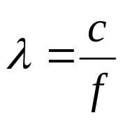
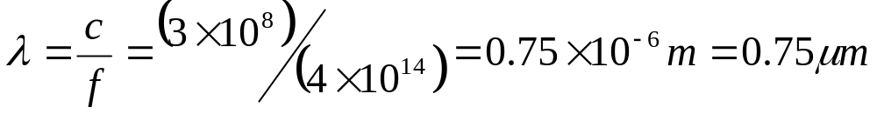
Wavelength and period
If we represent wavelength by λ, propagation speed by c (speed of light), and frequency by f, we get
The wavelength is normally measured in micrometers (microns) instead of meters.
For example, the wavelength of red light (frequency f=4 x 10¹⁴) in air is
In a coaxial or fiber-optic cable, however, the wavelength is lower (0.5μm) because the propagation speed in the cable is less than in the air.

Slide 17

Bandwidth-delay product
Bandwidth-delay product defines the number of bits that can fill the link.
Bandwidth-delay product = bandwidth ×delay
Example: Filling the link with bits for case 1

Slide 18
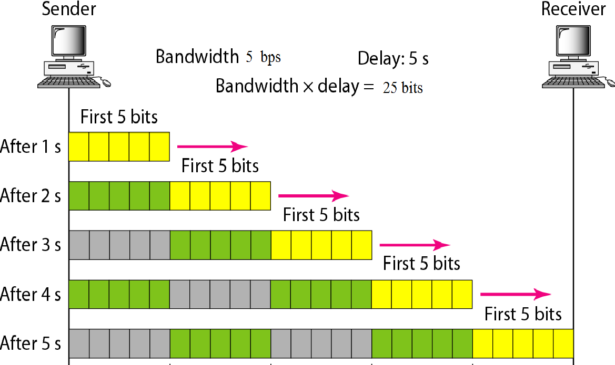
Bandwidth-delay product
Example: Filling the link with bits for case 2

Slide 19

Bandwidth-delay product
We can think about the link between two points as a pipe. The cross section of the pipe represents the bandwidth, and the length of the pipe represents the delay. We can say the volume of the pipe defines the bandwidth-delay product.

Slide 20
Question
Define Propagation delay and Transmission delay.
Question
Explain bandwidth-delay product with appropriate example.

Slide 21
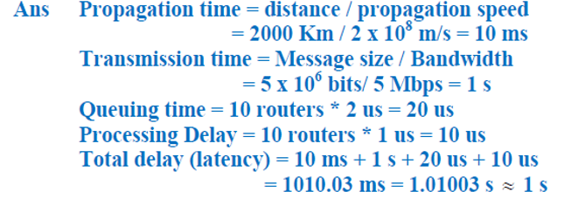
Question
What is the total delay (latency) for a frame of size 5 million bits that is being sent on a link with 10 routers each having a queuing time of 2 μs and a processing time of 1 μs. The length of the link is 2000 km. The speed of light inside the line is 2 ×10⁸ m/s. The link has a bandwidth of 5 Mbps.
Answer

